Slide 1
Cryptocurrency Analysis and Prediction
Sabbir Ahmad
Raghavendra Venkatesh
Jatin Taneja
College of Computer and Information Science | Northeastern University
CS6220 Spring 2018

Slide 2
Problem Statement
Recommend a new user a cryptocurrency to invest
Help the user to avail maximum benefit
Sub problems:
Explore dataset
Predict future data

Slide 3
Idea to Approach
Data Cleaning
Remove missing values
Data Analysis
Exploration to understand the data
Explore price trend, market share to see their pattern
Calculate volatility, fluctuations of the price and market share
Prediction
Train data with different models to predict price, market share, volume etc.
Normalize with different techniques (log, min-max, tanh)
Suggested models: GP-Flow, ARIMA, LSTM
Recommendation
Using prediction and coin properties recommend coin to an user

Slide 4
Dataset
Properties
Data size 69.4 MB
1,514 types of Cryptocurrencies
Number of instances: 702,166
Number of attributes: 13
Instances are records of different Cryptocurrencies at each day
Time range of collected data: 04-28-2013 to 02-21-2018

Slide 5
Dataset
Attributes
Coin name -> identifies the coin type
Date -> date of the instance
Open price -> opening price of the coin on that date in dollar
High price -> highest price of the coin on that date in dollar
Low price -> lowest price of the coin on that date in dollar
Close price -> closing price of the coin on that date in dollar
Volume -> The amount of coin traded on that date
Market cap -> total market value of a company's outstanding shares in dollar

Slide 6
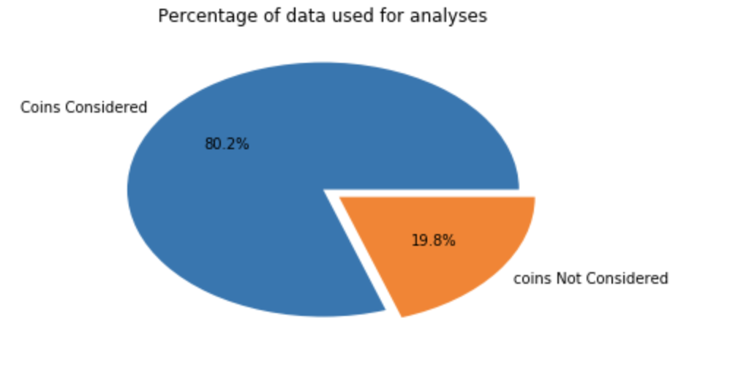
Data Cleaning
Missing Values
19.8% of coins were having market value 0.
Those are considered as “Missing values”.
And removed from data!

Slide 7
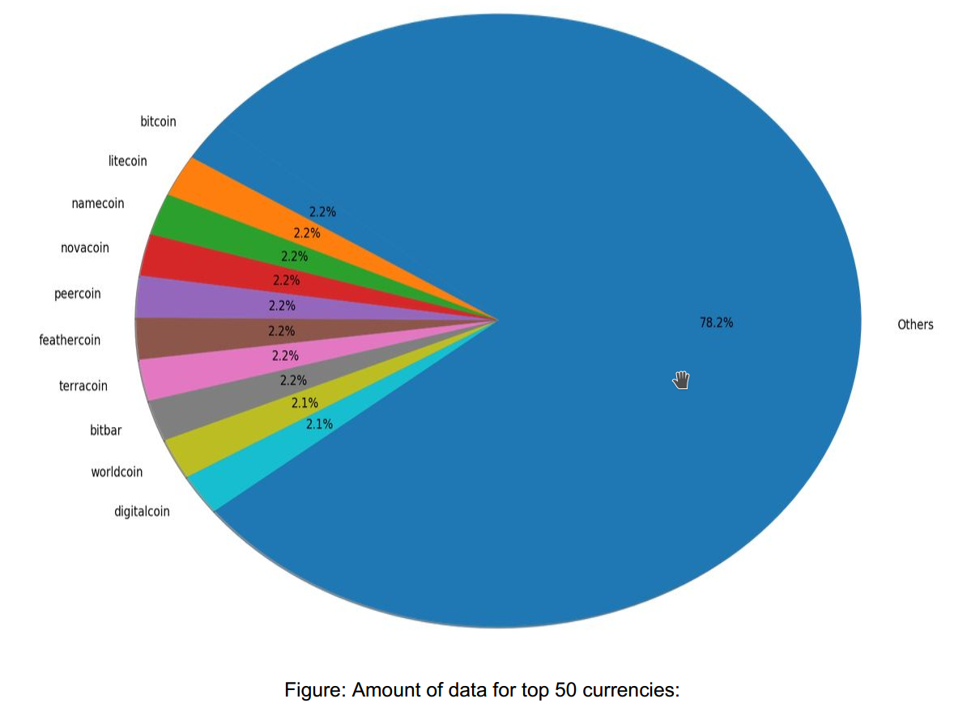
Data Exploration: Amount of Data

Slide 8
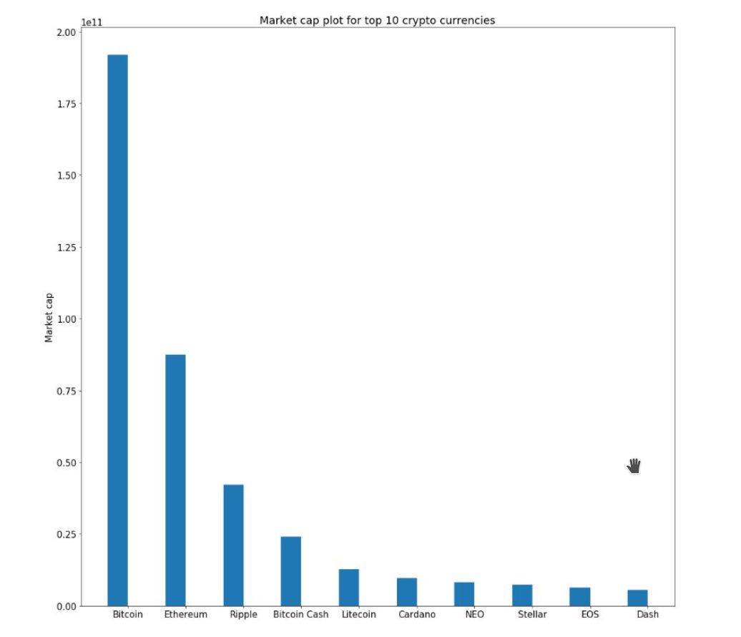
Data Exploration: Market Cap
Market cap: Top 10 coins
Ranking based on market cap value

Slide 9
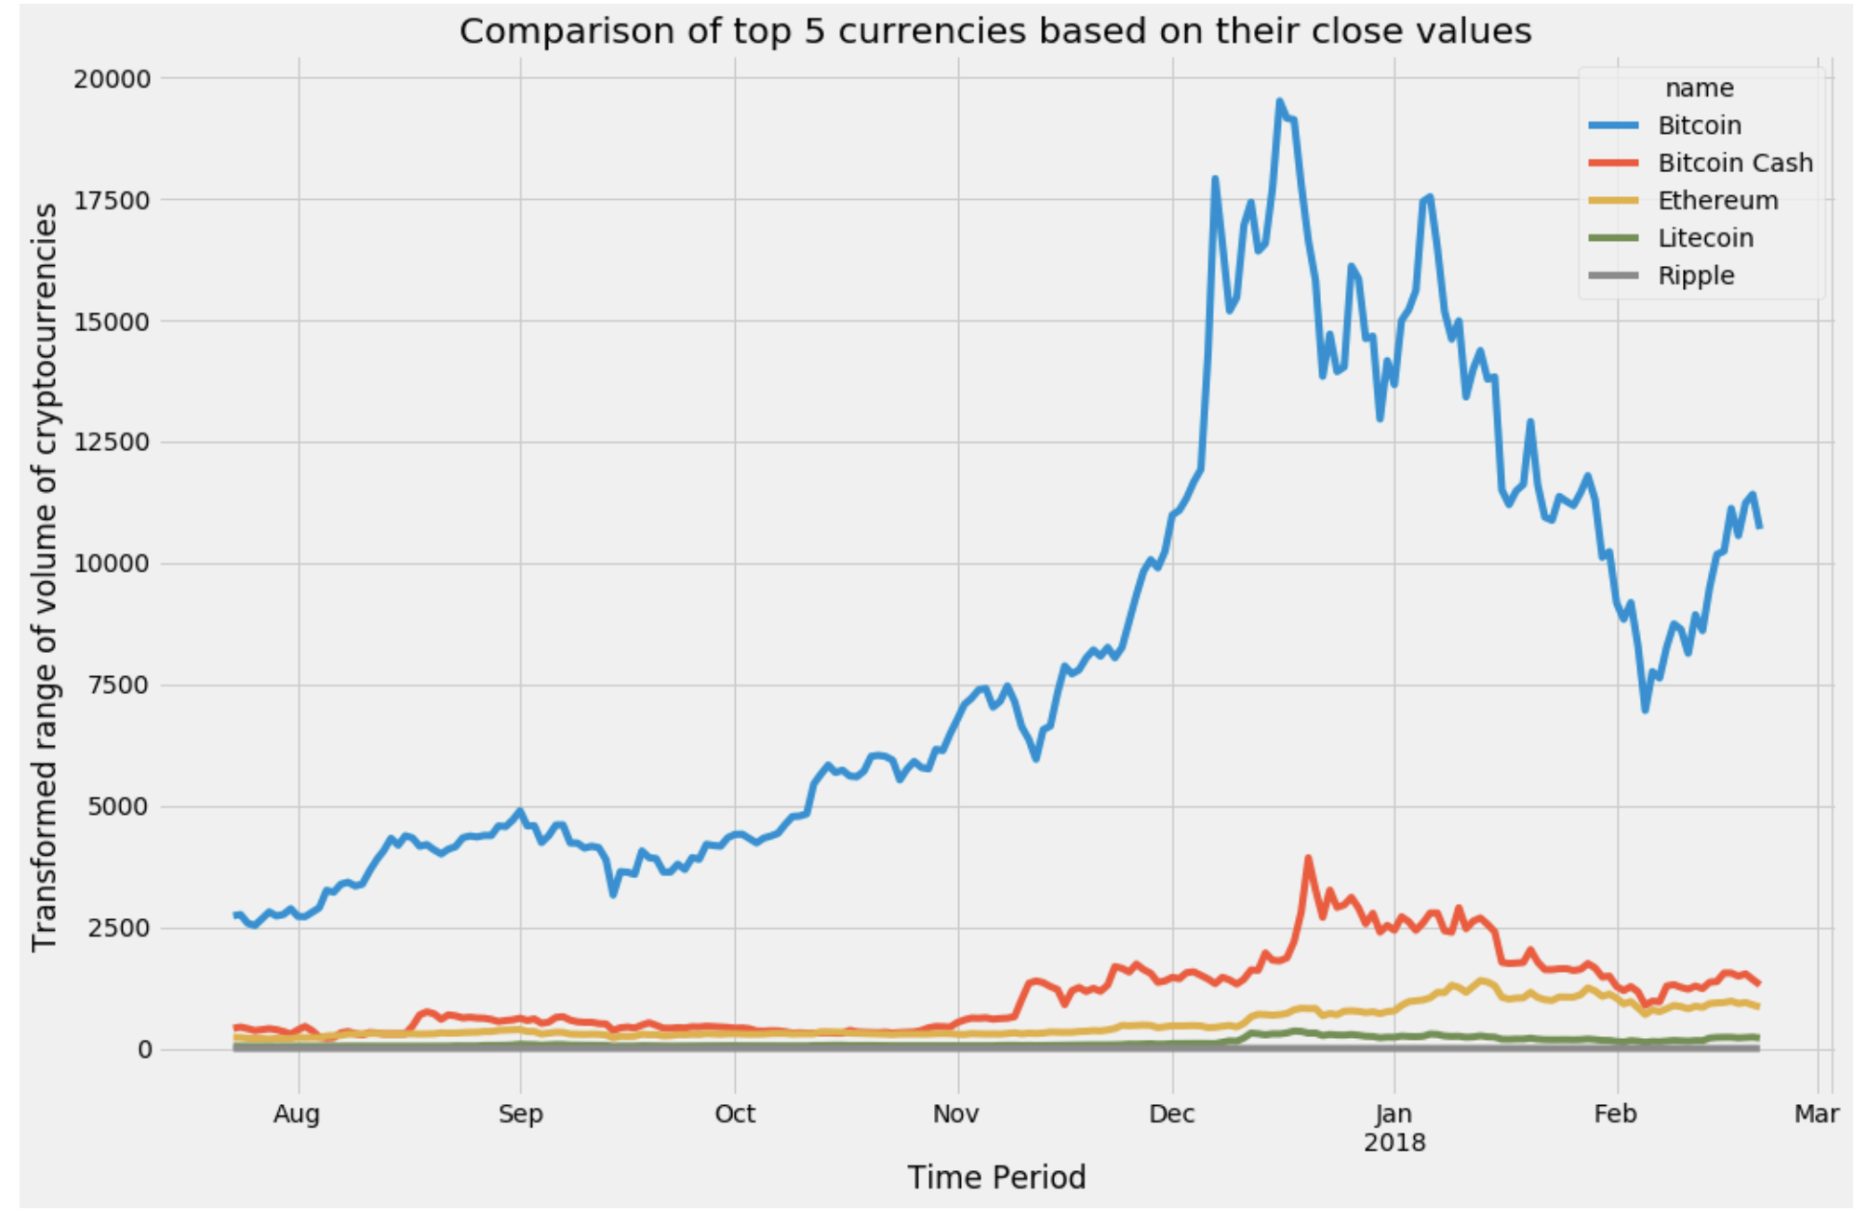
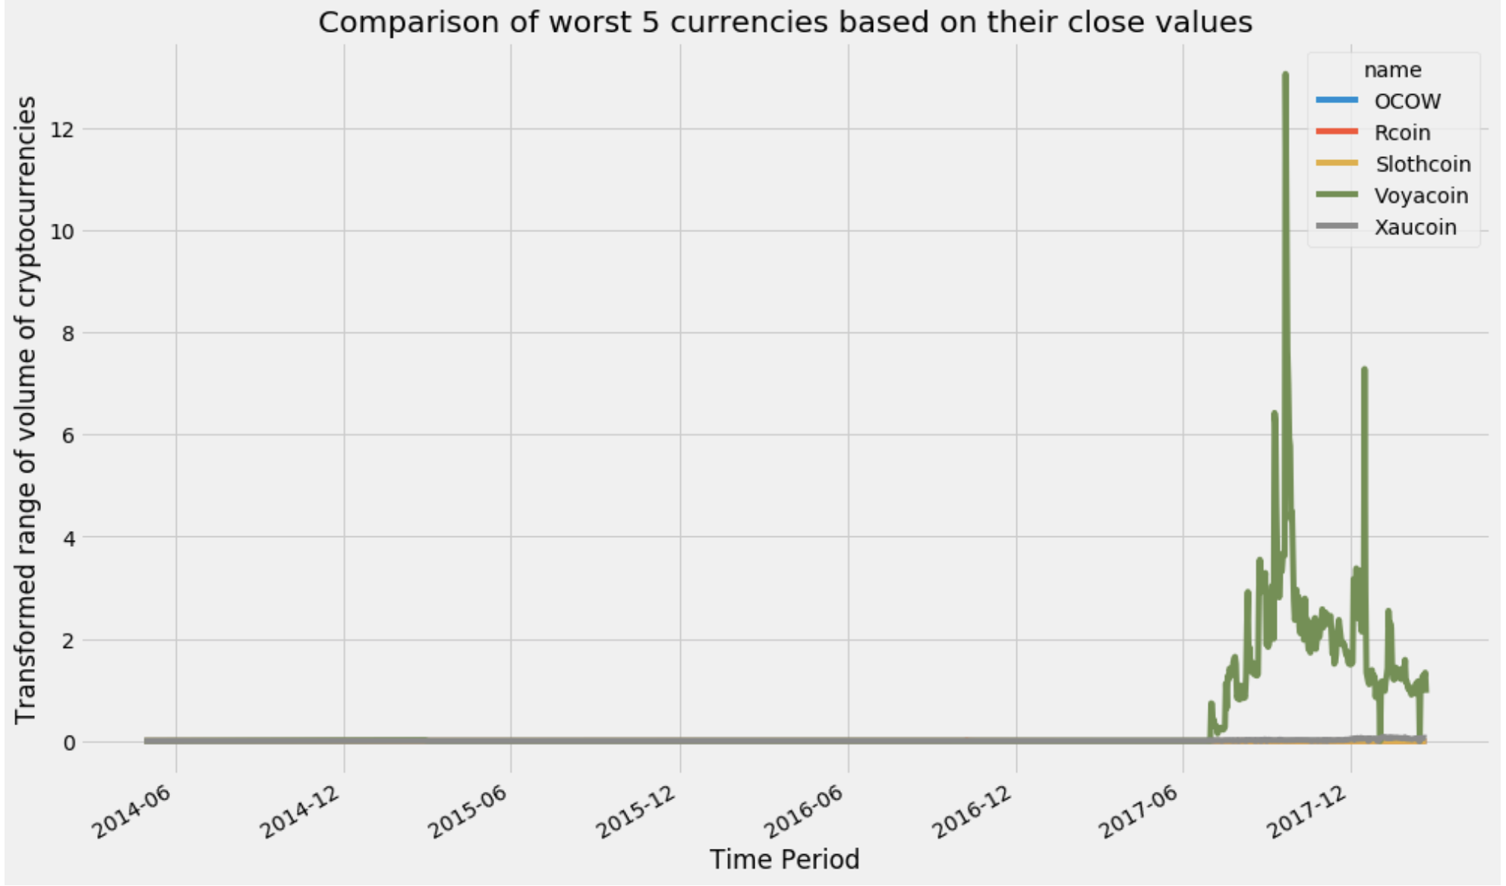
Data Exploration: Price Trend
Price Trend: Top & Worst 5 valuable coins close price trend
Evaluated on the basis of Market cap value

Slide 10
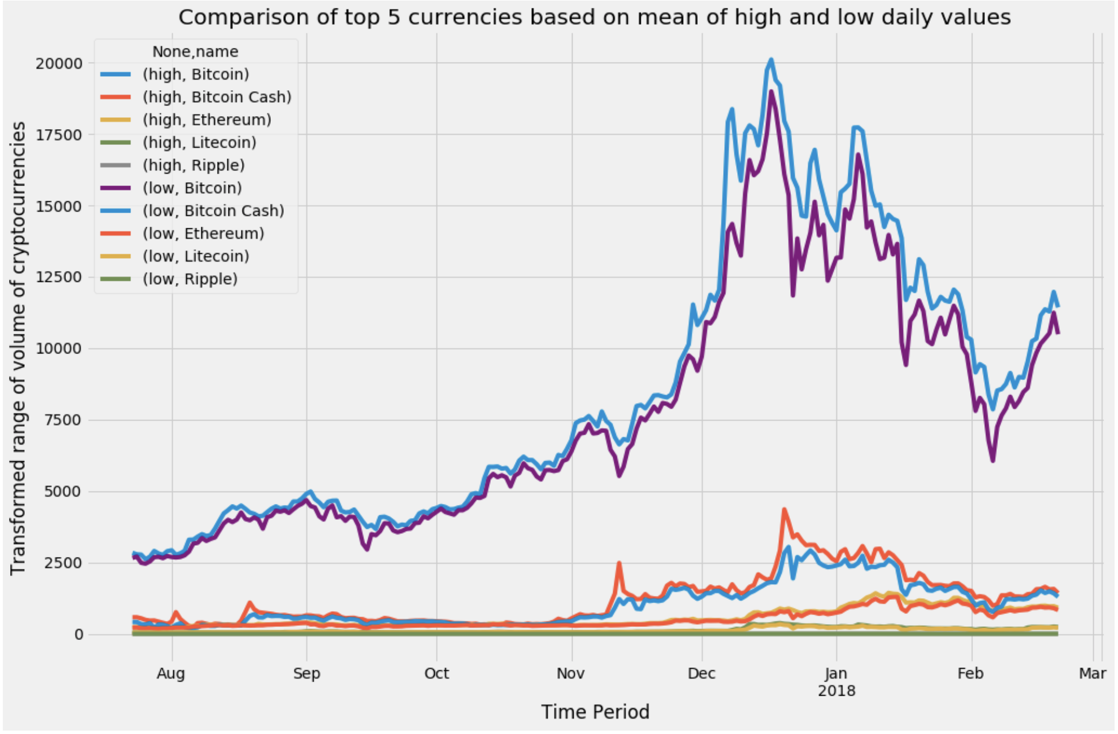
Data Exploration: Volatility
Volatility: Top 5 coins
Difference between high and low price represents volatility

Slide 11
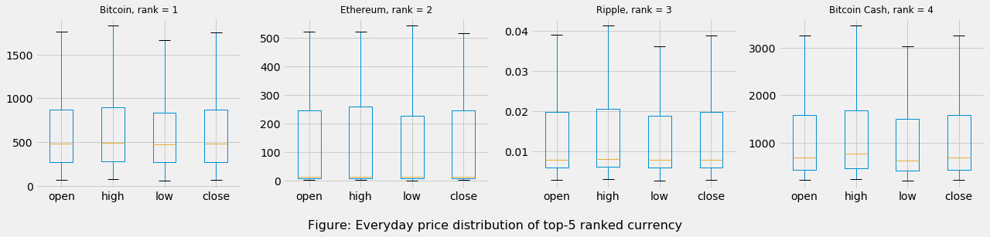
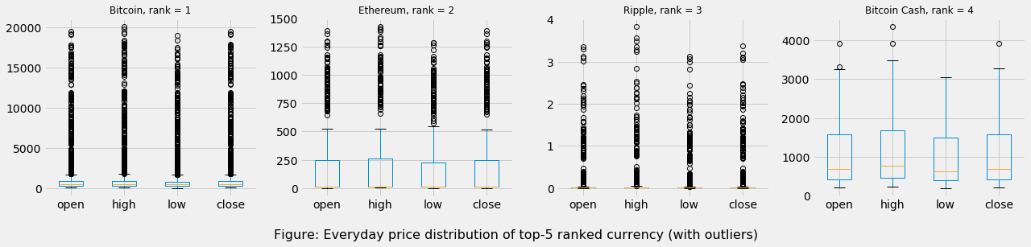
Data Exploration: Price Distribution
Ranked by Market cap:
Everyday price distribution for Top-5 Coins (click to see the outliers)
Plots show high prices for most of the coins that are top ranked.
From outlier plotting we see, outliers are very frequent in most coins.
So much outliers make handling of data difficult

Slide 12
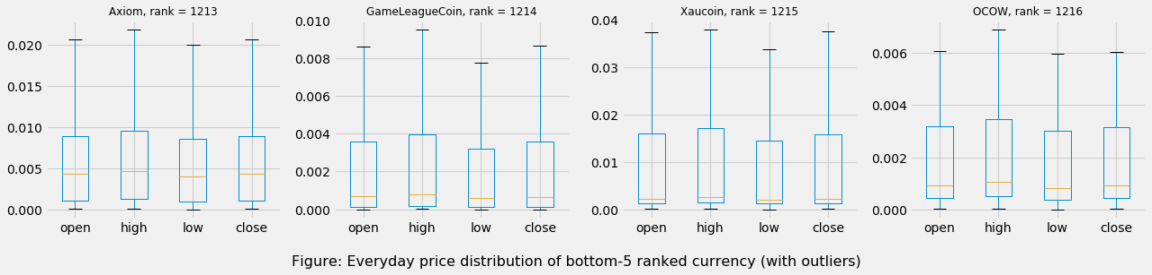
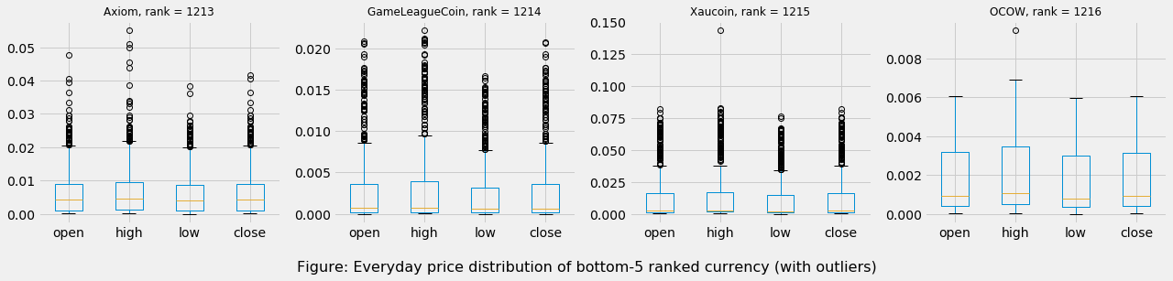
Data Exploration: Price Distribution
Ranked by Market cap:
Everyday price distribution Bottom-5 Coins (click to see the outliers)
Plots show low prices for most of the coins that are bottom ranked.
From outlier plotting we see, outliers are very frequent in most coins.
So much outliers make handling of data difficult

Slide 13
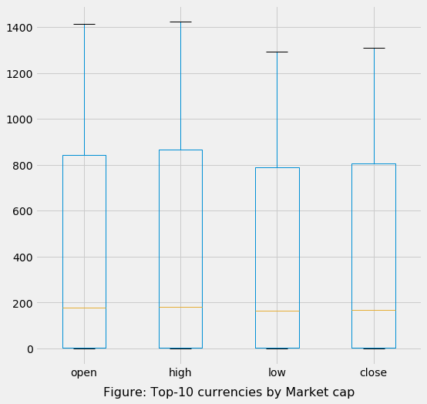
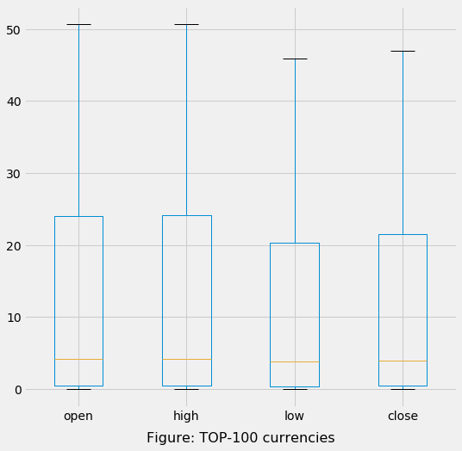
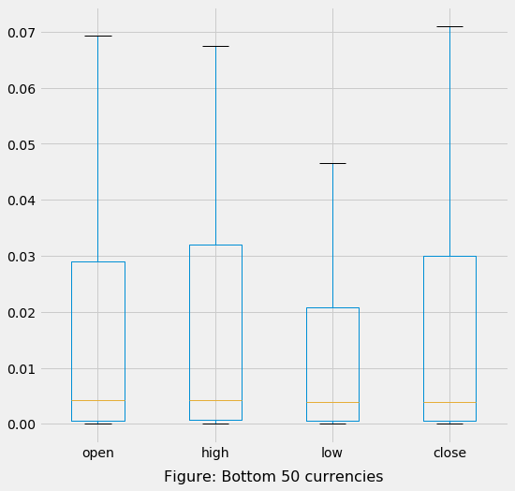
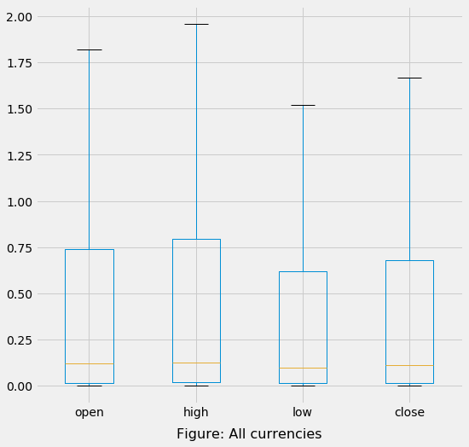
Data Exploration: Price Distribution
Better visualization on price distribution
Price distribution on a specific day for a number of coins - February 21, 2018
Top-10 shows high price distribution
Price range decreases as more coins are considered (i.e. Top 100)
Price is very low for Bottom-100 coins
Considering all the coins, prices are low as well

Slide 14
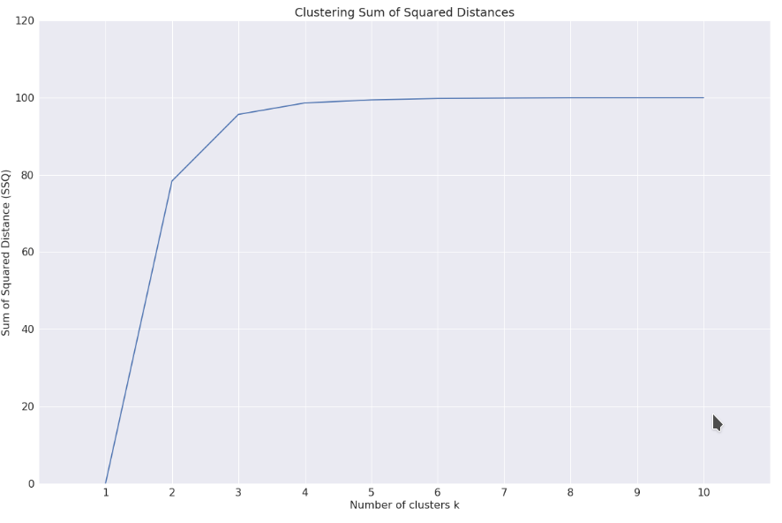
Data Exploration: Clustering Coins
The elbow point is at 4 hence appropriate number of clusters is 4

Slide 15
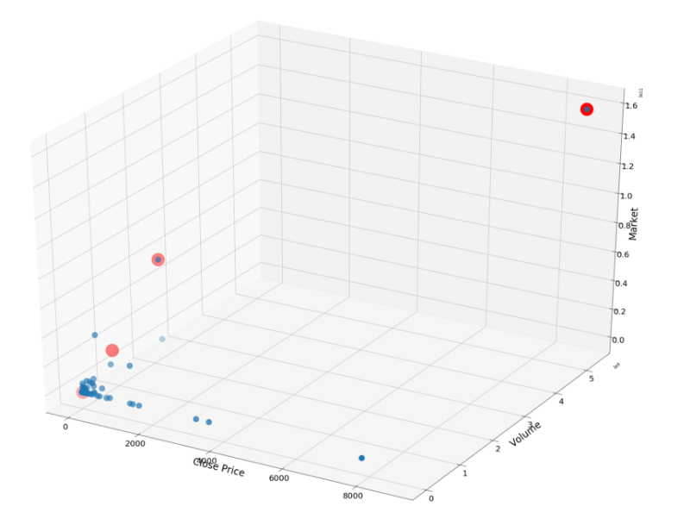
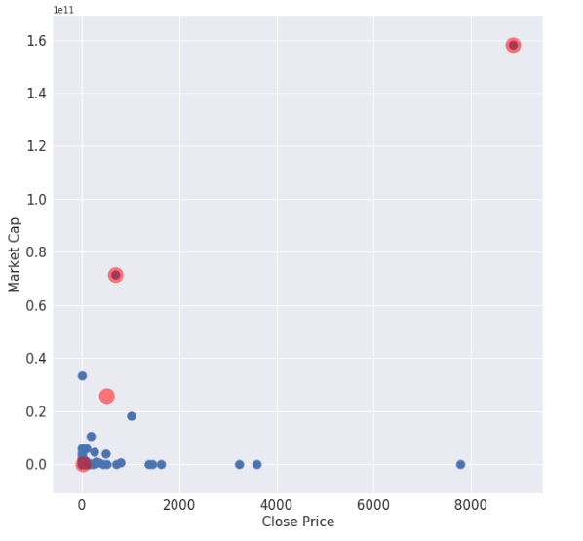
Data Exploration: Clustering Coins
Using features: Close Price, Market cap
Using features: Close price, Market cap, Volume

Slide 16
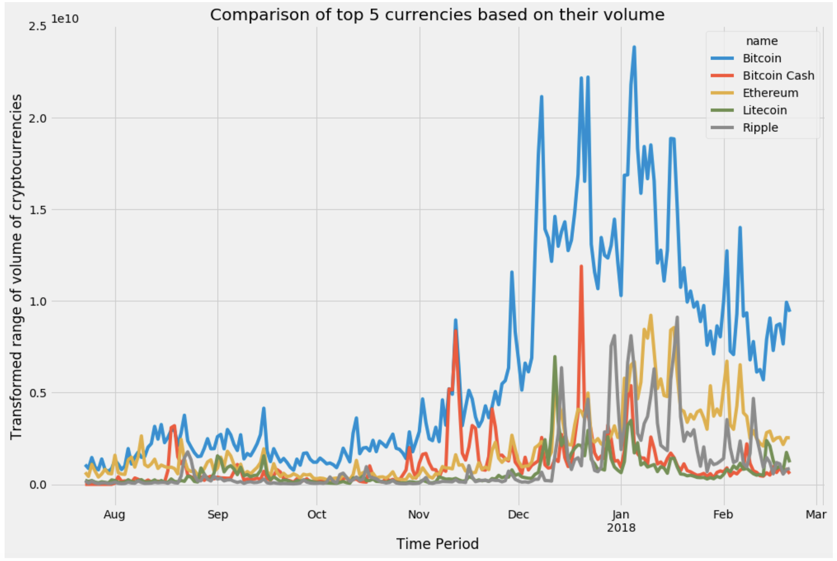
Data Exploration: Coin Transaction
Most Transactions (volume): Coins in which people prefer to use
Based on the number of transactions per day

Slide 17
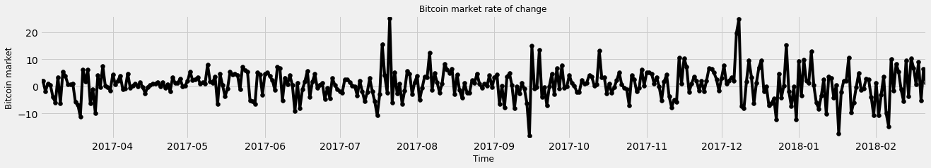
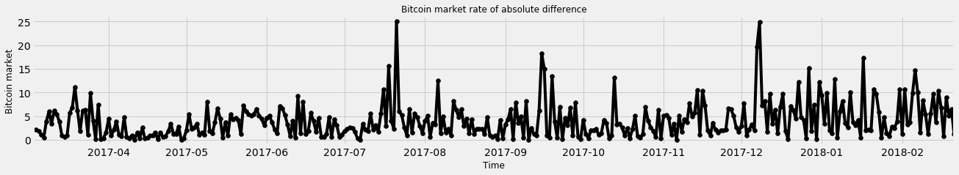
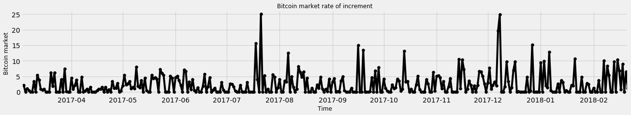
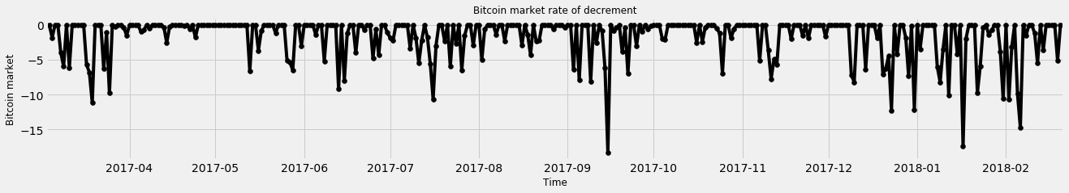
Data Exploration: Fluctuations
Fluctuation example with Bitcoin
Rate of change
Rate of absolute difference
Rate of increment
(negative values clamped to zero)
Rate of decrement
(positive values clamped to zero)

Slide 18
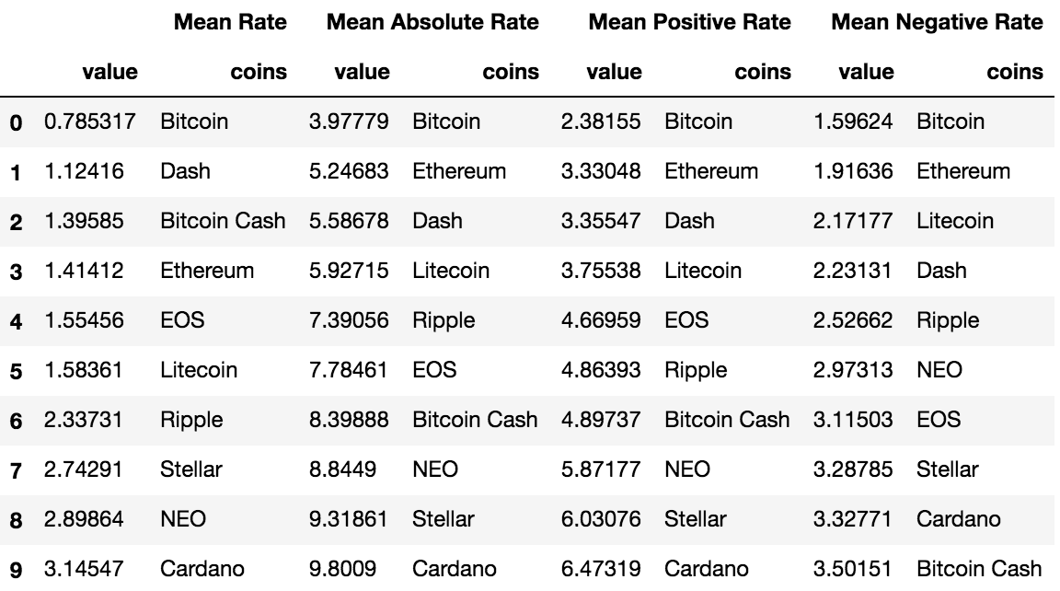
Data Exploration: Fluctuations
Comparison of fluctuations of Top-10 coins
Mean Absolute Rate mostly shows the fluctuations
Mean Rate comprises of positive and negative changes
Example
Bitcoin has minimum fluctuation in rates
Bitcoin Cash has low mean rate change, but high Absolute rate change.

Slide 19
Data Exploration: Fluctuations
Comparison of Mean Rate fluctuations
82 coins (7.28%) have mean rate <= 0
1045 coins (92.72%) have mean rate > 0
Negative mean rate indicates the coin has overall ‘bad performance’
High mean rate indicates the coin has higher increment than decrement

Slide 20
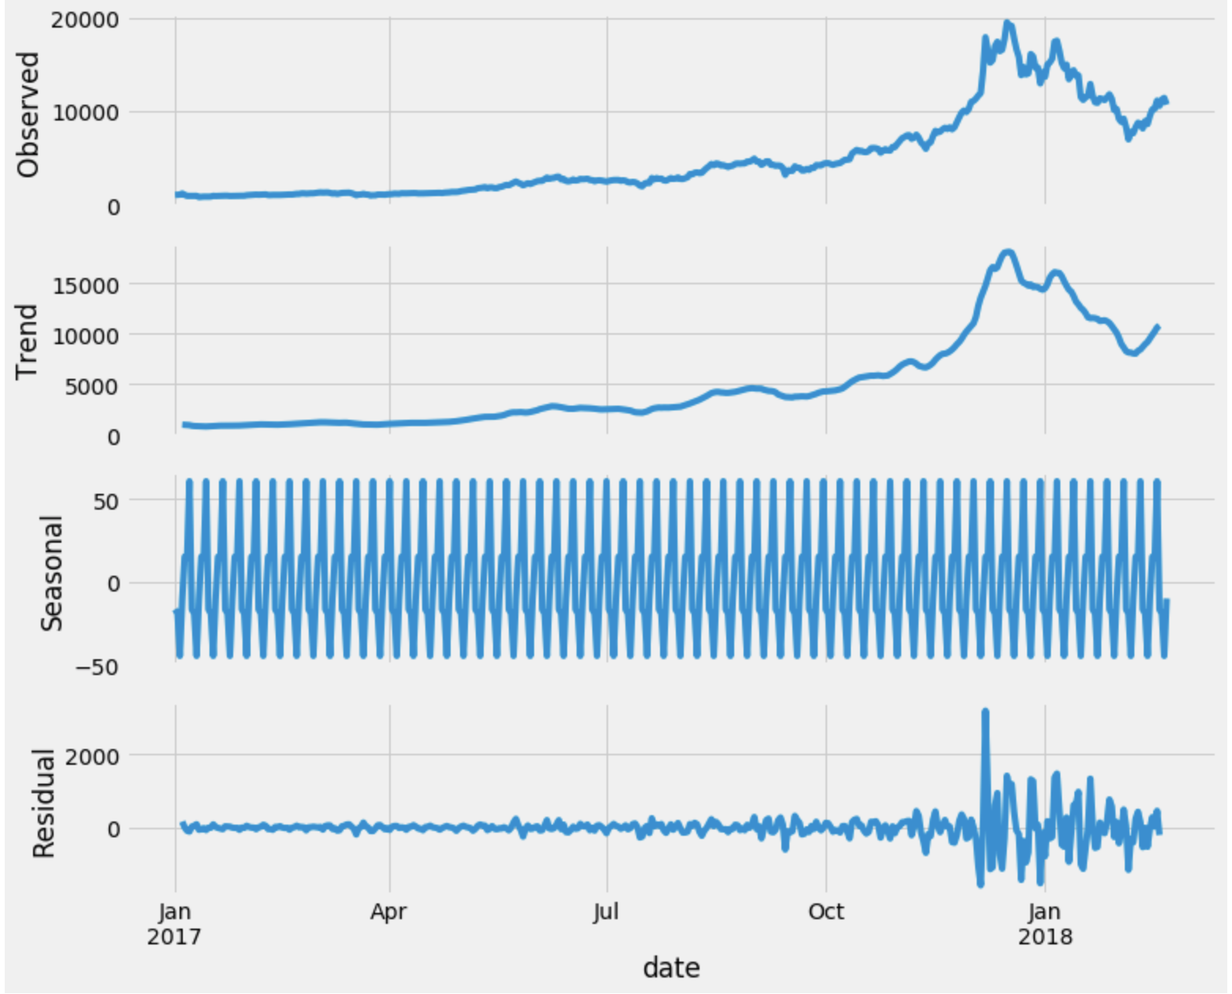
Seasonality
Seasonality of time series having price information only

Slide 21
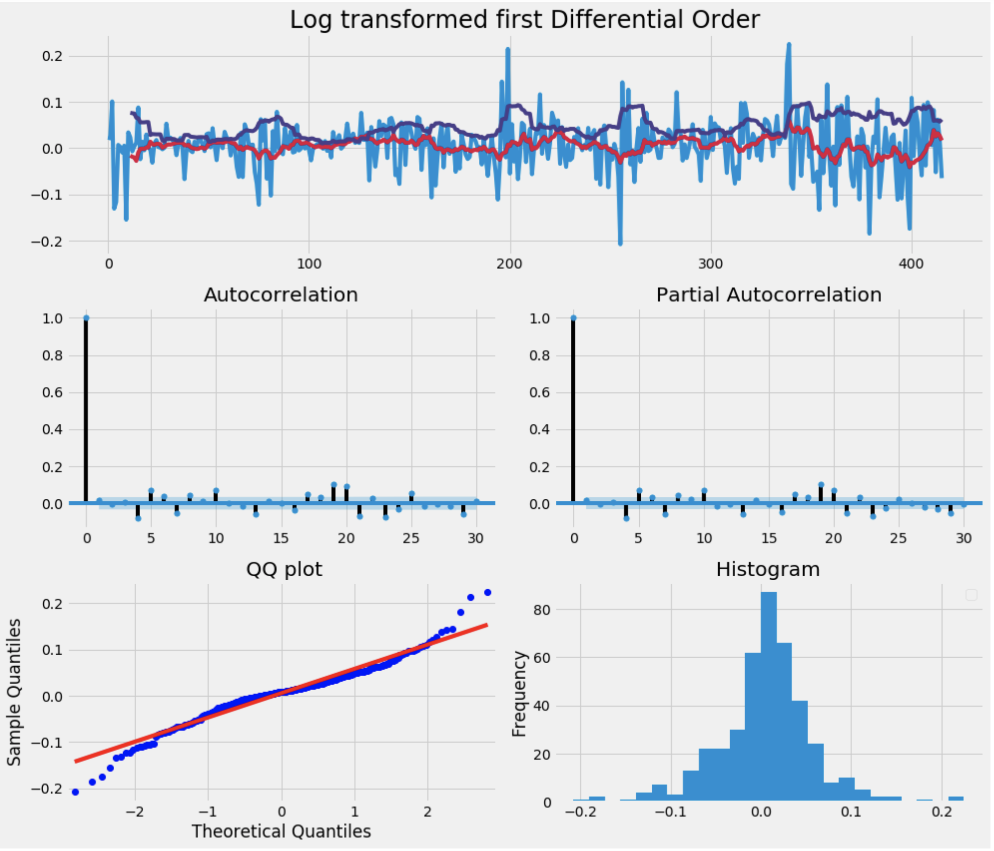
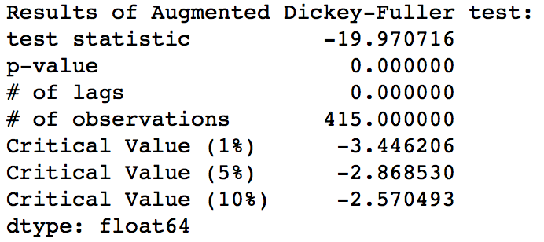
Seasonality
Transformed price series to remove seasonality
Verified the resultant series is fit for ARIMA model
Using Dickey-Fuller test

Slide 22
Observation of Transformed Series
Graph of autocorrelation and partial autocorrelation shows that log operation and first order difference on price series have resulted into a non stationary series.
The QQ plot and histogram shows that error are normally distributed.
Dickey fuller test confirms us the similar information.
Test statistics is below 5% of critical value
P-value is below 5% moving average

Slide 23
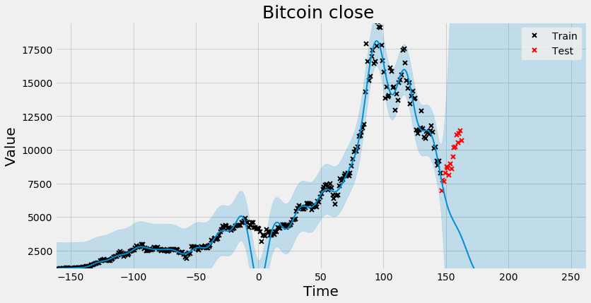
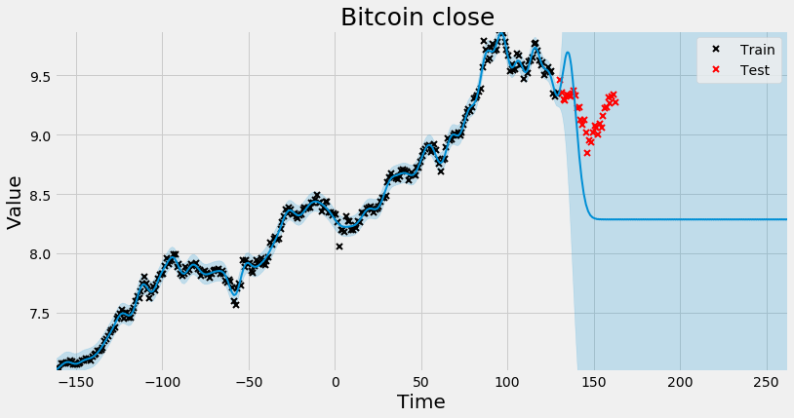
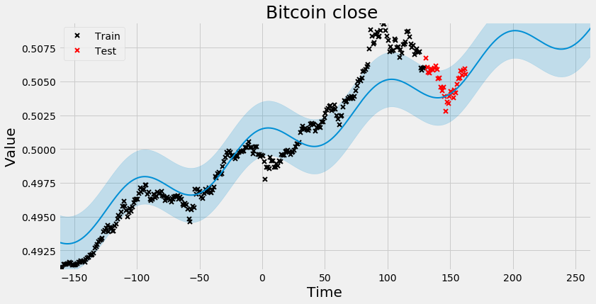
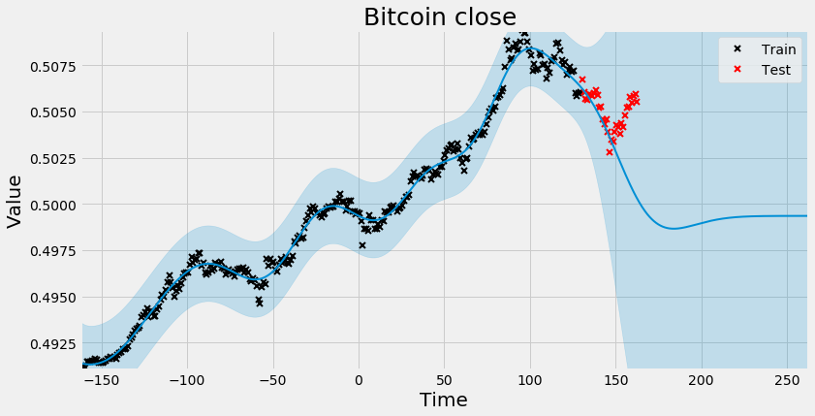
Prediction
Using GP-Flow package
Different normalization are used for better training
Different kernels are used for prediction
Figure: Not normalized, Kernel: constant + rbf*linear
Figure: Log normalized, Kernel: constant + rbf*linear
Figure: Log and tanh normalized, Kernel: constant + rbf*linear + periodic
Figure: Log and tanh normalized, Kernel: constant + rbf*linear

Slide 24
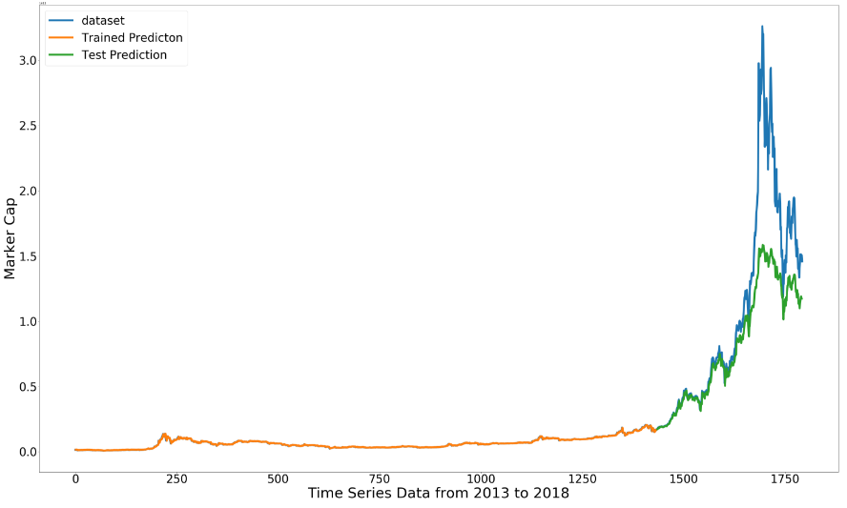
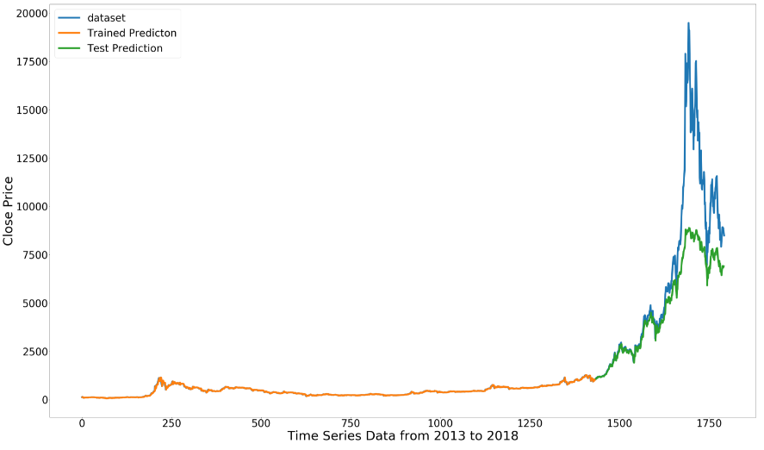
Prediction
Using Keras LSTM Package
Using tanh activation
Root Mean Square Error
Train Score: 338929104.22
Test Score: 44736505478.74
Root Mean Square Error
Train Score: 24.60
Test Score: 2825.58
Figure: Prediction on Market cap
Figure: Prediction on close price

Slide 25
Currently working on…
Training different models for prediction
Regression with mixture of different kernels
Neural Network
Deep Learning Models
Auto-Regressive Models for Time Series
Prediction for price, market cap and volume
Using prediction to recommend coins to users

